Slide 1


Network Meeting Updates
Presented by: Rebecca Dugger, MHA, MA, ACPAR, APM, MCMP-II, SSBBP
Director, Program and Community Support
Service Delivery and Administration
Georgia Department of Community Health
Date:02/16/2022

Slide 2

Mission
The mission of the Department of Community Health is to provide access to affordable, quality health care to Georgians through effective planning, purchasing,
and oversight.
We are dedicated to A Healthy Georgia.

Slide 3
Purpose
Shaping the future of A Healthy Georgia by improving access and ensuring quality to strengthen the communities we serve.

Slide 4

Outline
Appendix K
Advertising of EDWP- “Structured Family Caregiving”
Vaccine Mandates
Rate Increase
Title or Chapter Slide
(use as needed; feel free to delete)

Slide 5
Appendix K
Provisions contained within the Appendix K are in effect until the end of the PHE.
The state has submitted an amendment to adjust the roll-back period for another 6 months following the official conclusion of the PHE.
Services and provisions will vary. Please review all Banner messages, emails and training regarding this matter.

Slide 6
Part I 106. General Conditions of Participation As general conditions of participation, all enrolled providers must:
E) Not contact, provide gratuities or advertise “free” services to Medicaid or PeachCare for Kids members for the purpose of soliciting members’ requests for services. Any activity such as obtaining a list of Medicaid or PeachCare for Kids members or canvassing neighborhoods for direct contact with Medicaid or PeachCare for Kids members is prohibited. Any offer or payment of remuneration, whether direct, indirect, overt, covert, in cash or in kind, in return for the referral of a Medicaid or PeachCare for Kids member is also prohibited. It is not the intent of this provision to interfere with the normal pattern of quality medical care that results in follow-up treatment. Direct contact of patients for follow-up visits is not considered solicitation, nor is an acknowledgment that the provider accepts Medicaid/PeachCare for Kids patients.
F) Allow Medicaid or PeachCare for Kids members the opportunity to choose freely among available enrolled providers. It is not the intent of this provision to preclude referrals to other enrolled providers when medically necessary.

Slide 7

Advertising Do’s
What is the service ?
What are the qualifications to participate ?
What are the expectations of caregivers ?
How to apply ?

Slide 8

Advertising Don’ts
Indicate stipends are tax-free
Everyone is eligible
Imply that SFC is a stand-alone service outside of the EDWP.
Make offers for renumeration outside of the stipend paid to caregivers as allowed in the waiver.

Slide 9
Mass Adjustments
Each waiver program has completed the updates to the PAs.
Mass Adjustments have been requested by Gainwell this week.
Adjustments will take 30-60 days to complete.

Slide 10
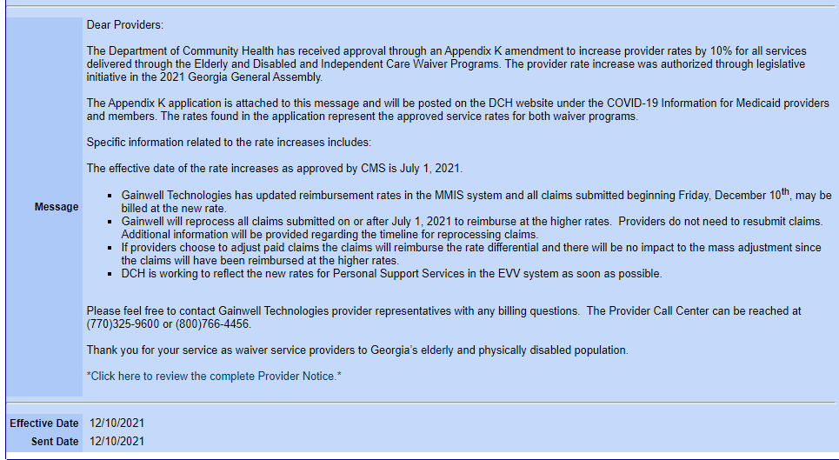
Banner Message for Rate Increase

Slide 11
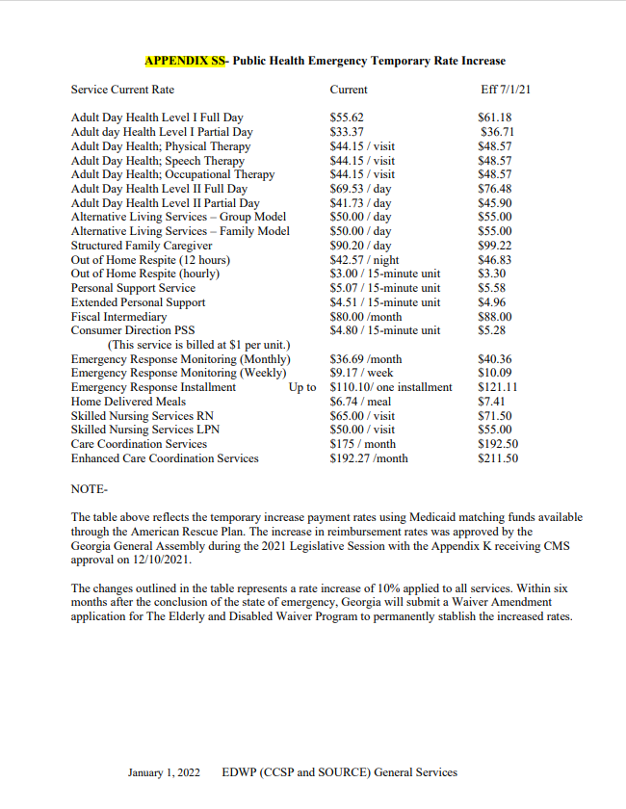
EDWP Rate Increase
The following are the temporary rate increases for EDWP services. DCH will make the application for the rate increases at the conclusion of the PHE.

Slide 12
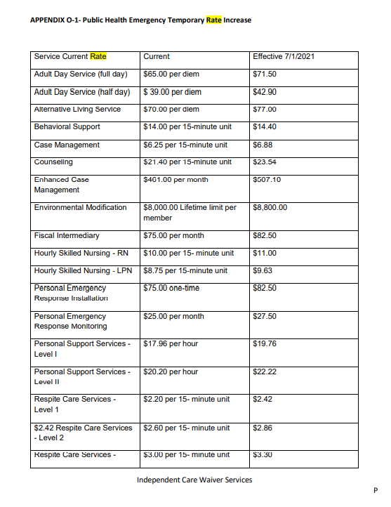
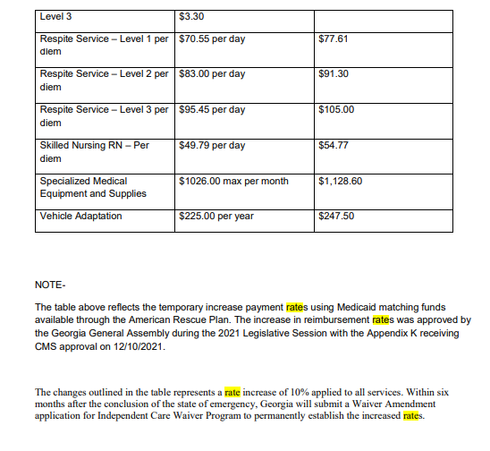
ICWP Rate Increase

Slide 13
Vaccine Mandates
DCH has not required providers of Home and Community Based Services (HCBS) to enact any kind of vaccine mandates. Other provider types will be required.
See attached FAQ for those provider types.
CMS Guidance- https://www.cms.gov/COVIDvax

Slide 14
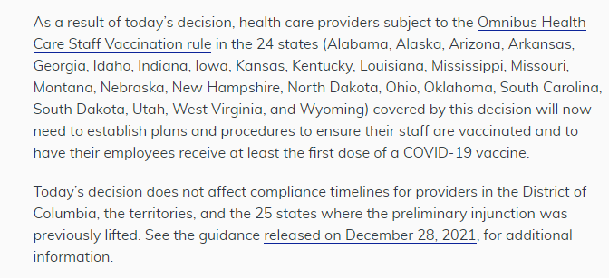
Ruling in Brief

Slide 15

Questions
Rebecca Dugger, Director- rdugger@dch.gov
Jill Crump - EDWP/CCSP jill.crump@dch.ga.gov
Carolyn Porter- EDWP/SOURCE carolyn.porter@dch.ga.gov
Vonnie Stelly- ICWP vstelly@dch.ga.gov
Atiya Hasan- Provider enrollment Ahasan@dch.ga.gov

